Slide 1
BITS Pilani presentation
Prof. T S L Radhika
Dept. of Mathematics, Hyderabad Campus

Slide 2
<SS ZC416, MFDS>
Lecture No. 7

Slide 3
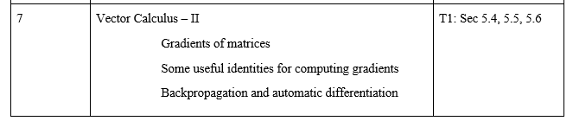
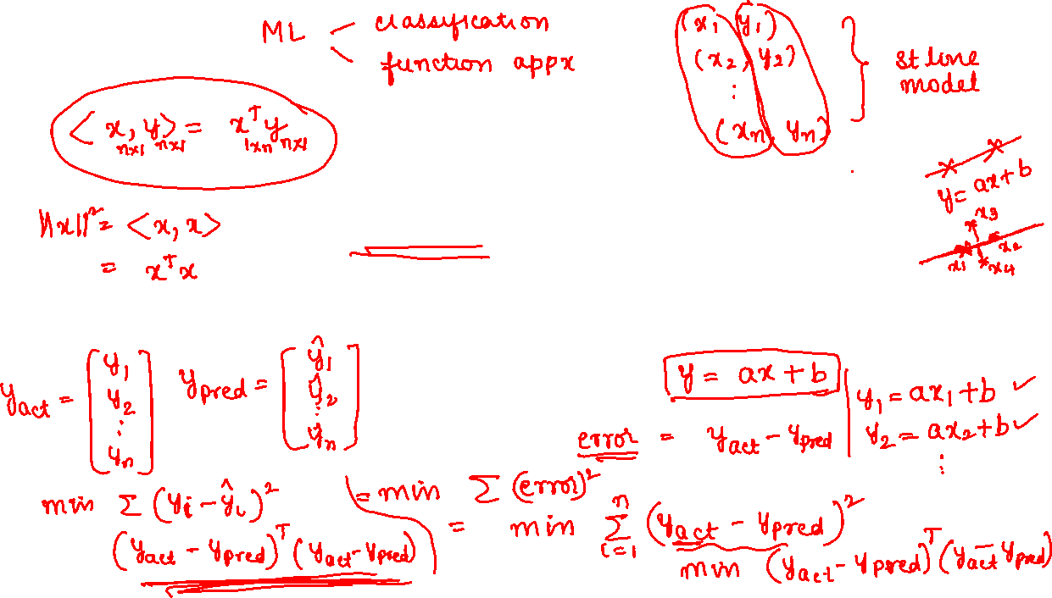

Slide 4
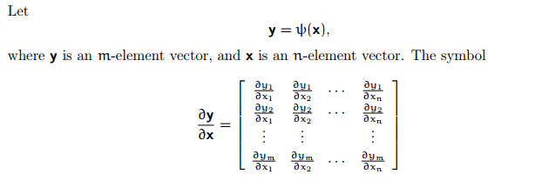
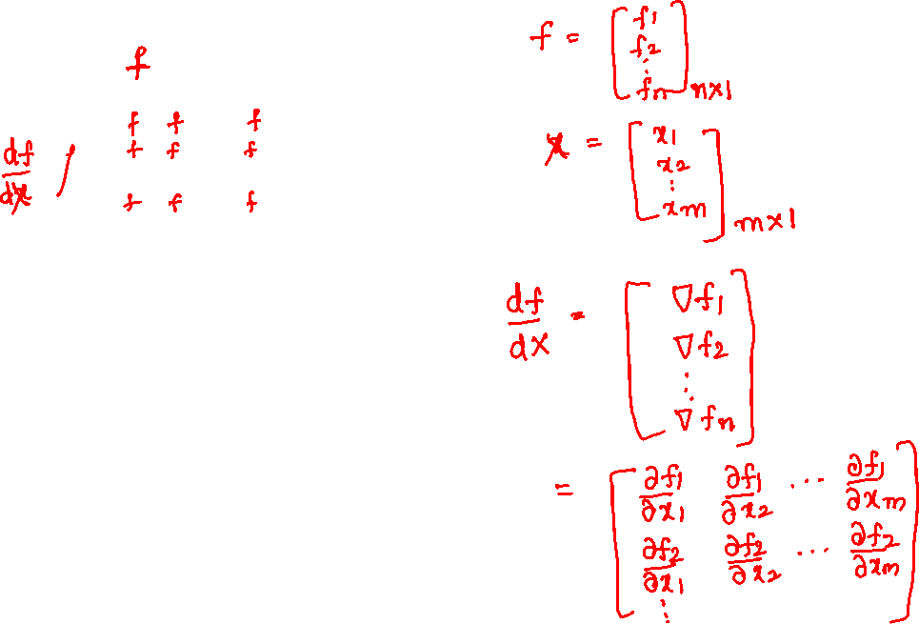

Slide 5
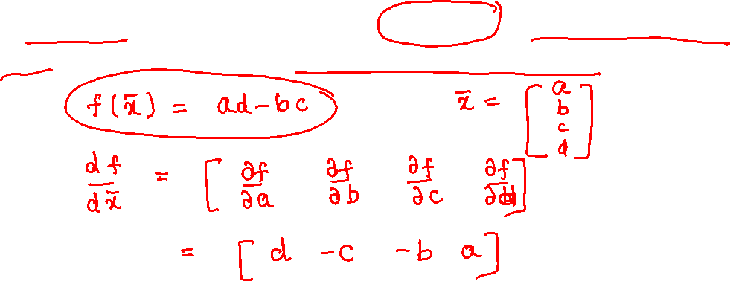
Let $f\left(\overline{x}\right)=\det{A}$, where $A=\left[\begin{matrix}a & b \\ c & d\end{matrix}\right],a,b,c,d$ are all positive reals and $a$is much greater than the other elements. Find $\frac{df}{d\overline{x}}$ and determine to which element is the function $f$ more sensitive.

Slide 6
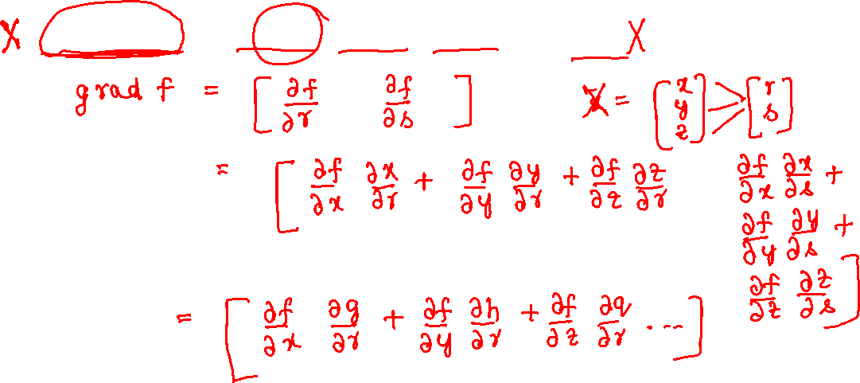
If $f\left(\overline{x}\right)=xy+z^{3}−sinxy$ where $x=g\left(r,s\right),y=h\left(r,s\right),z=q\left(r,s\right)$. Find $grad f\left(\overline{x}\right)$.

Slide 7


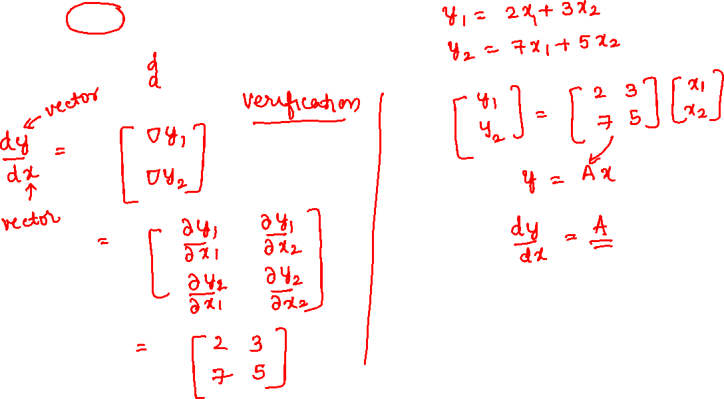

Slide 8


Slide 9

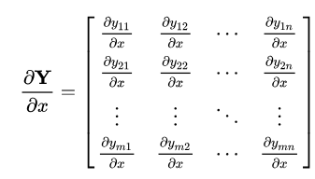
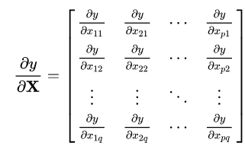

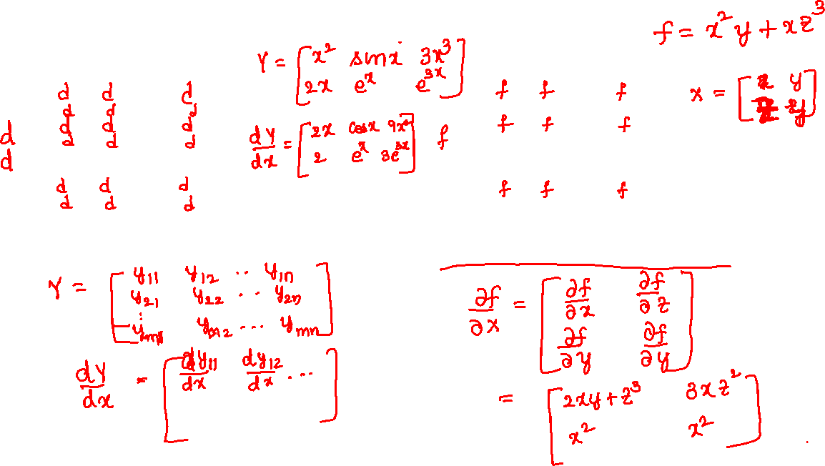
Gradient of a matrix with respect to scalar
Gradient of a scalar with respect to matrix

Slide 10
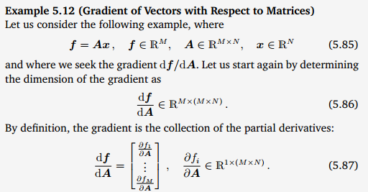

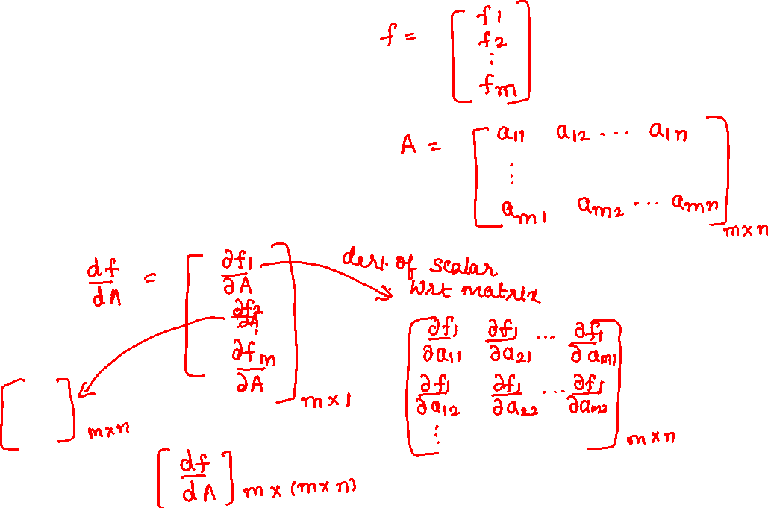

Slide 11
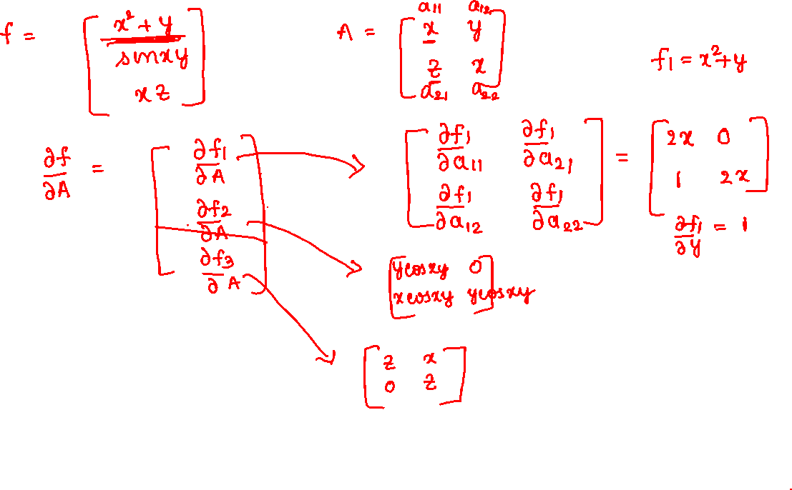

Slide 12
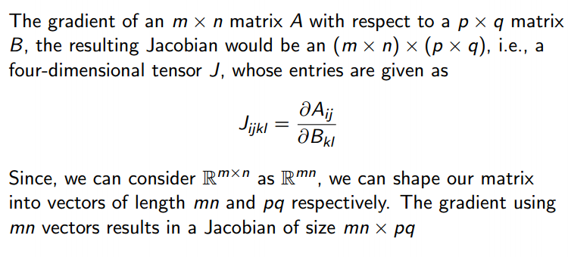
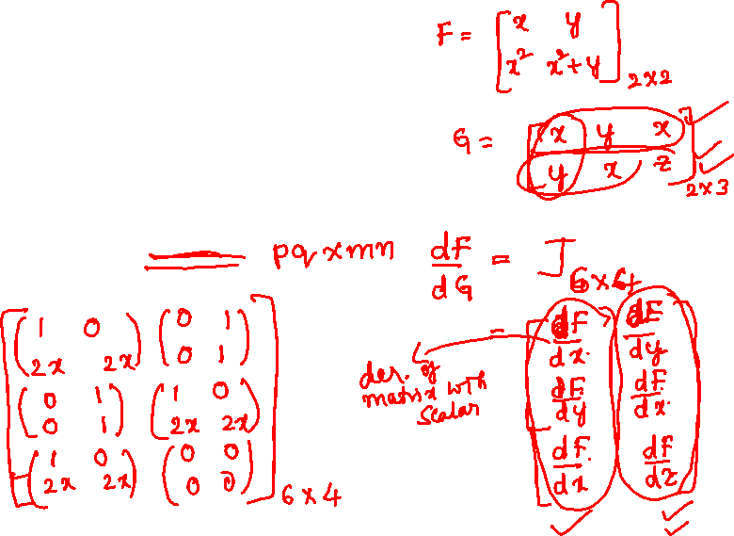

Slide 13
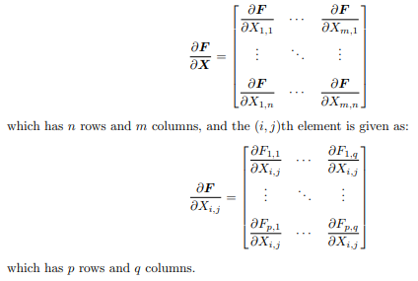
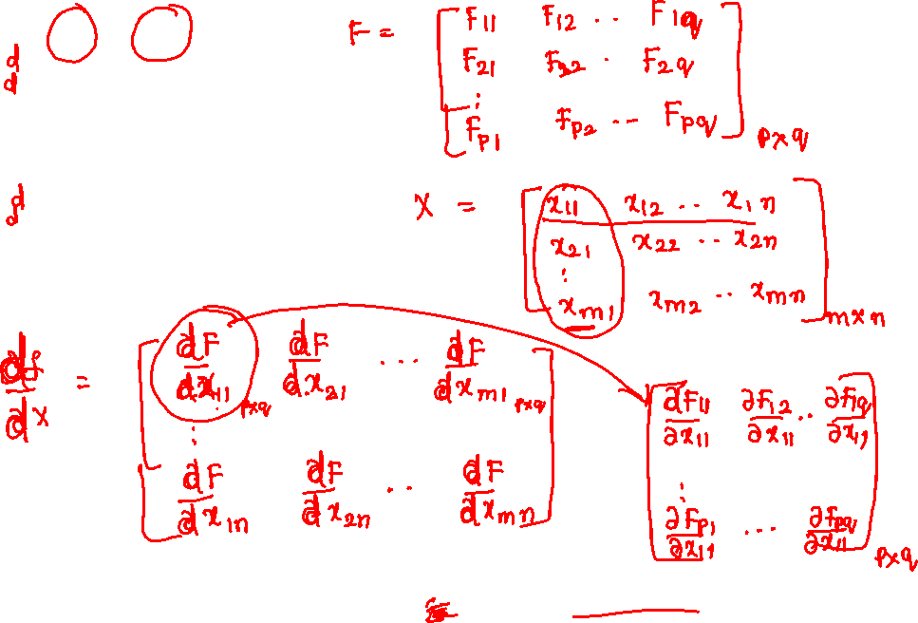

Slide 14



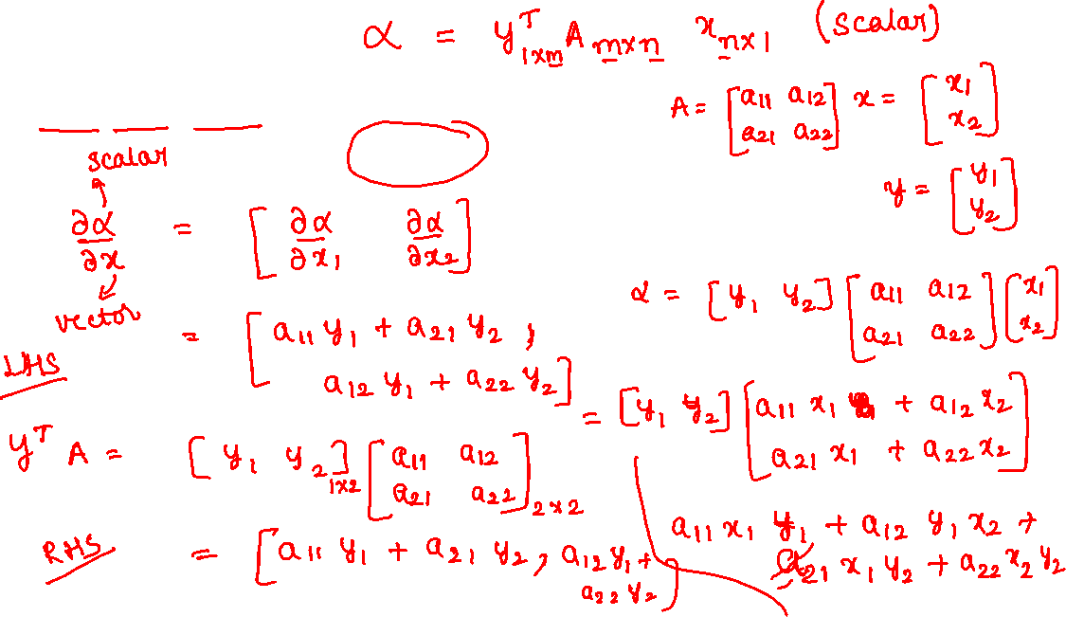

Slide 15
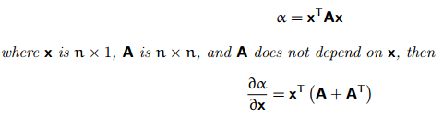
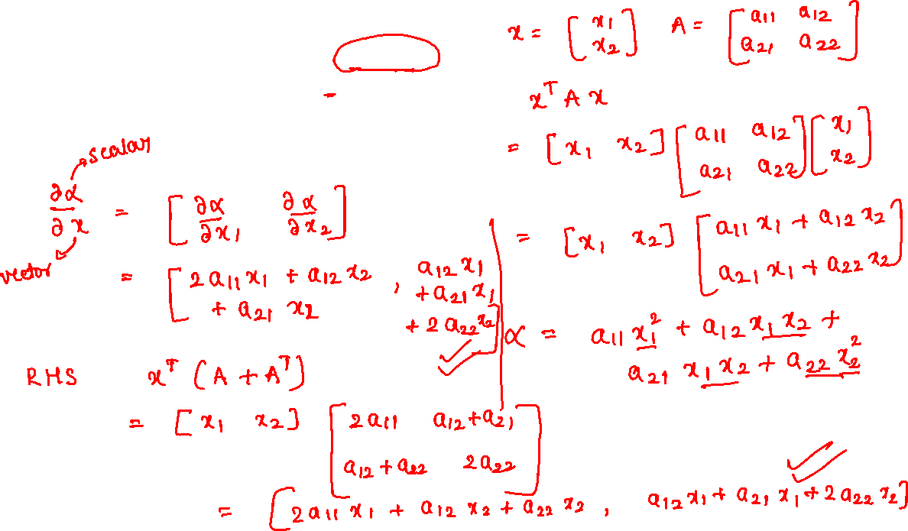

Slide 16




Slide 17
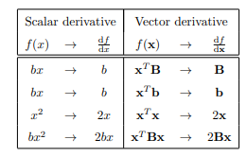

Slide 18
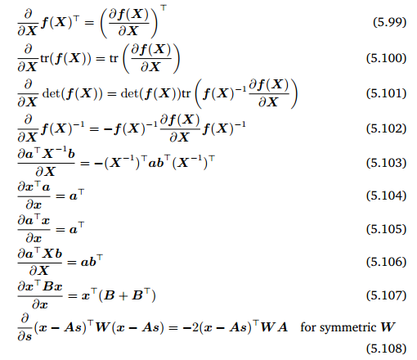


Slide 19
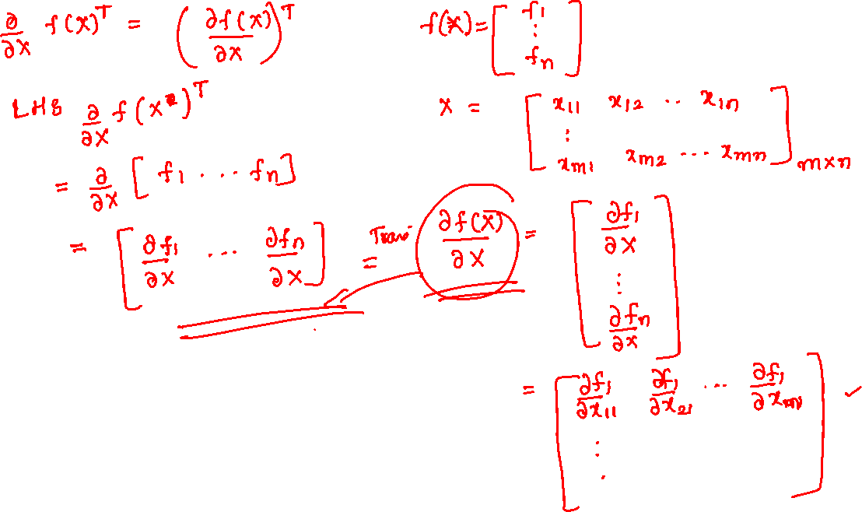

Slide 20
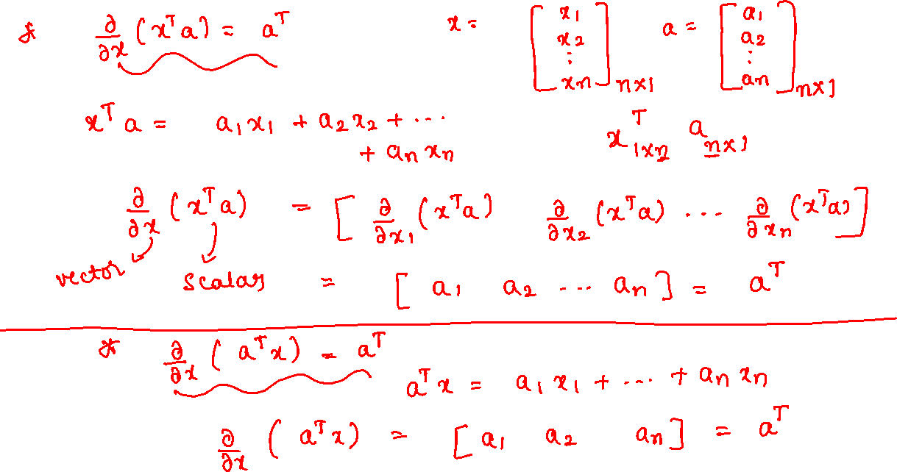

Slide 21
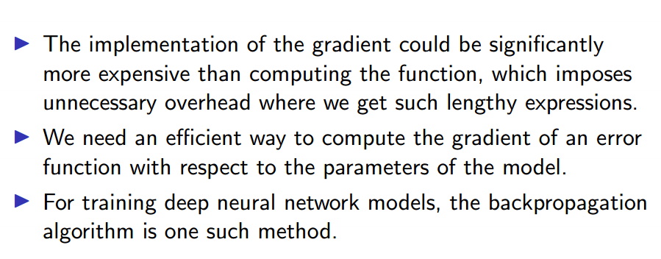
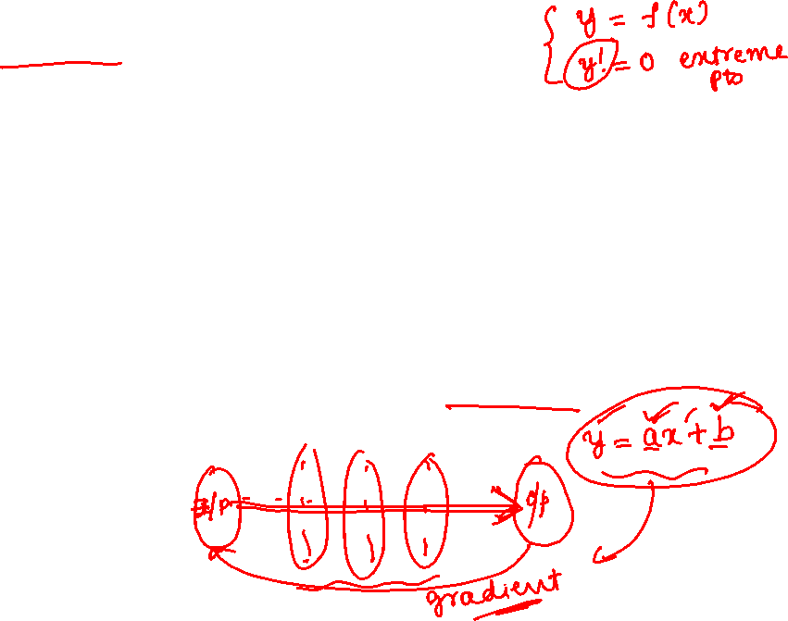

Slide 22
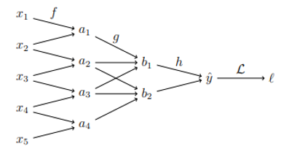
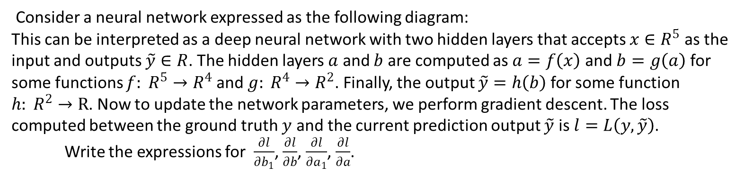
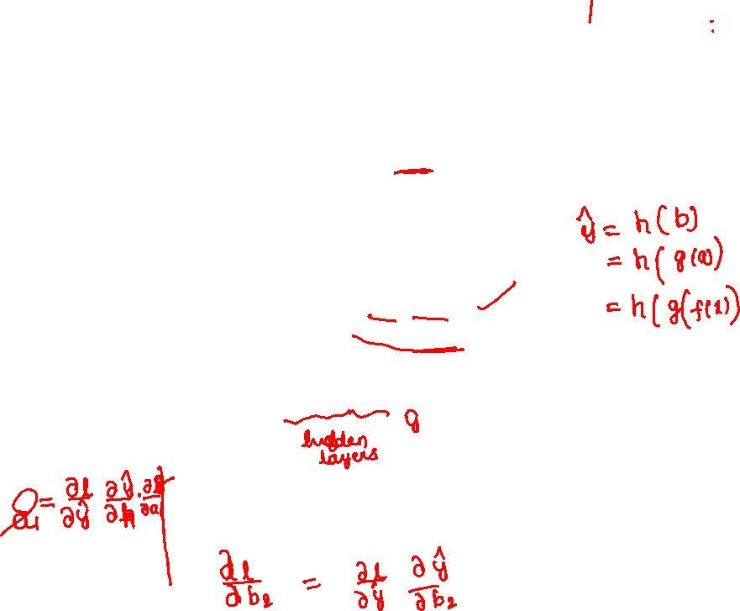
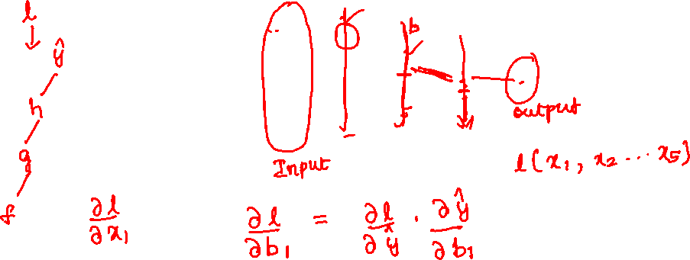
Consider a neural network expressed as the following diagram:
This can be interpreted as a deep neural network with two hidden layers that accepts ${x∈R}^{5}$ as the input and outputs $\tilde{y}∈R$. The hidden layers $a$ and $b$ are computed as $a=f\left(x\right)$ and $b=g\left(a\right)$ for some functions $f: R^{5}→R^{4}$ and $g: R^{4}→R^{2}$. Finally, the output $\tilde{y}=h\left(b\right)$ for some function $h: R^{2}→R$. Now to update the network parameters, we perform gradient descent. The loss computed between the ground truth $y$ and the current prediction output $\tilde{y}$ is $l=L\left(y,\tilde{y}\right)$.
Write the expressions for $\frac{∂l}{∂b_{1}}$, $\frac{∂l}{∂b}$, $\frac{∂l}{∂a_{1}}$, $\frac{∂l}{∂a}$.

Slide 23
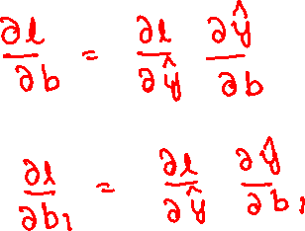

Slide 24
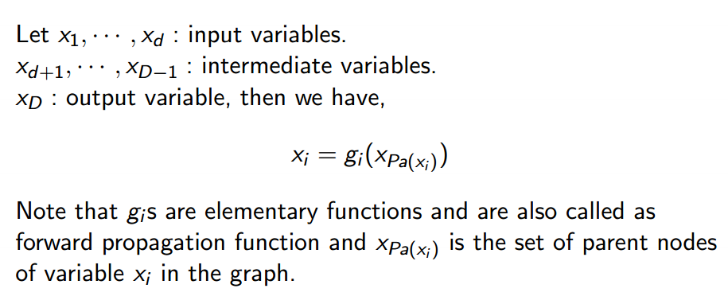

Slide 25
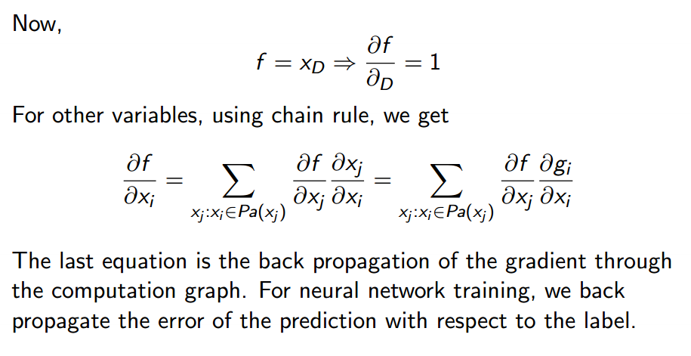

Slide 26
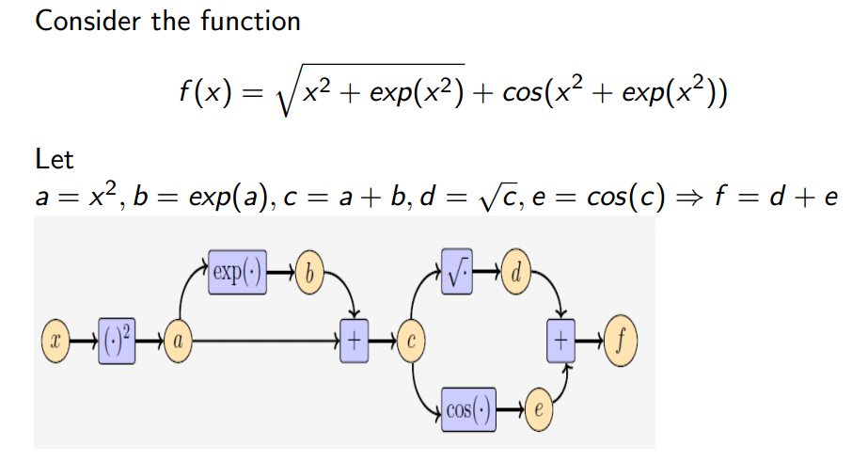

Slide 27
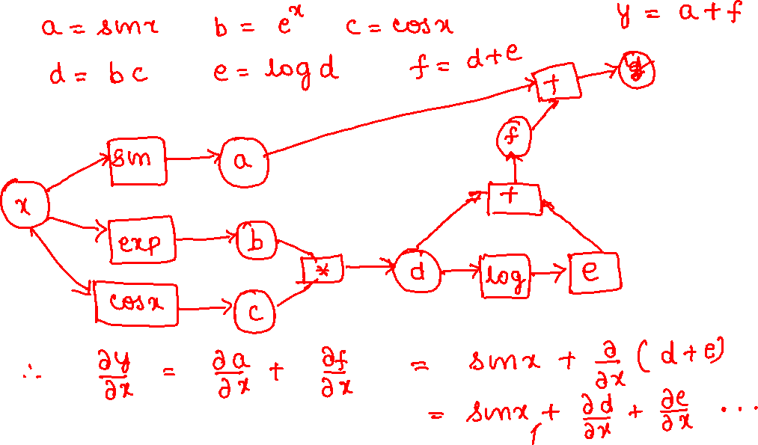
Draw a neural network to evaluate the derivative of the function $y=sinx+e^{x}cosx+log\left(e^{x}cosx\right)$ using the back-propagation technique.

